Slide 1
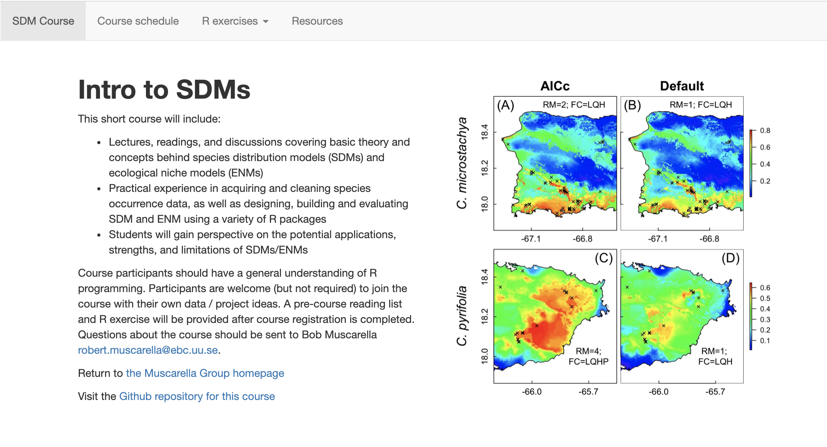
Potentials and Pitfalls
Bob Muscarella
Sapienza University, Roma
June 9-11
Course website: https://bobmuscarella.github.io/SDM-course/index.html

Slide 2
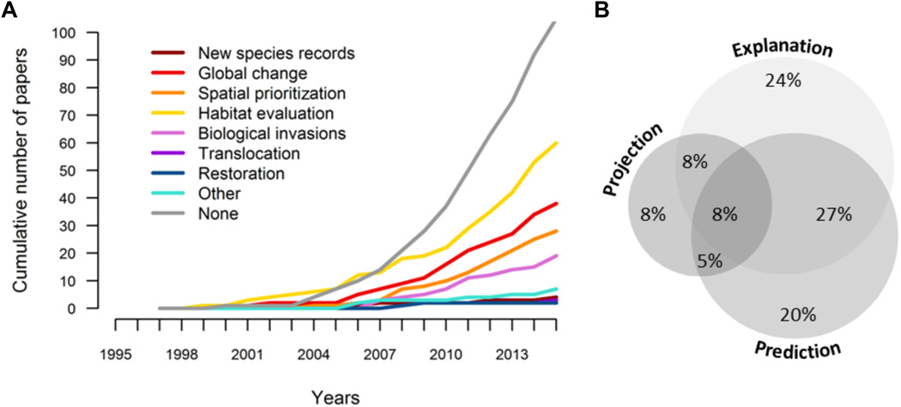
Applications of SDMs
Araújo et al. (2019) Standards for distribution models in biodiversity assessments. Science Advances
Notes:
Uses of SDMs. Classification of published species distribution modeling studies by (A) type of biodiversity assessment accomplished with the trend in the numbers of studies shown over time and (B) purpose of the model (see glossary in text S4). In (A), the trend for translocation is very similar to that of restoration, and hence is hardly visible. The classification is based on a random sample of 400 papers (of 6483 identified articles mentioning statistical models of species distributions); 238 of the randomly selected papers used SDMs and were included in this analysis. Details on the literature search and analyses appear in text S1, figs. S1.1, S1.2, S1.3, and S1.4, and tables S1.1, S1.2, and S1.3.

Slide 3
(Some) Potential applications of SDMs/ENMs
Niche structure and limits (ecological / evolutionary application)
Discovery of species and populations
Consequences of climate change
Reconstructing past distributions
Invasive species applications
Systematic conservation planning
Large-scale conservation/restoration projects
Public health

Slide 4
Niche structure and limits
Evolutionary hypotheses
Niche conservatism?
Niche divergence?
Evans et al. (2009) Climate, Niche Evolution, and Diversification of the “Bird‐Cage” Evening Primroses. The American Naturalist. 173(2): 225-240.

Slide 5
Niche structure and limits
Evolutionary hypotheses
Niche conservatism?
Niche divergence?
Kozak & Weins (2006) Does niche conservatism promote speciation? A case study in north American salamanders. Evolution 60(12): 2604–2621
Kozak et al. (2008) Integrating GIS-based environmental data into evolutionary biology. Trends in Ecology & Evolution 23(3)

Slide 6
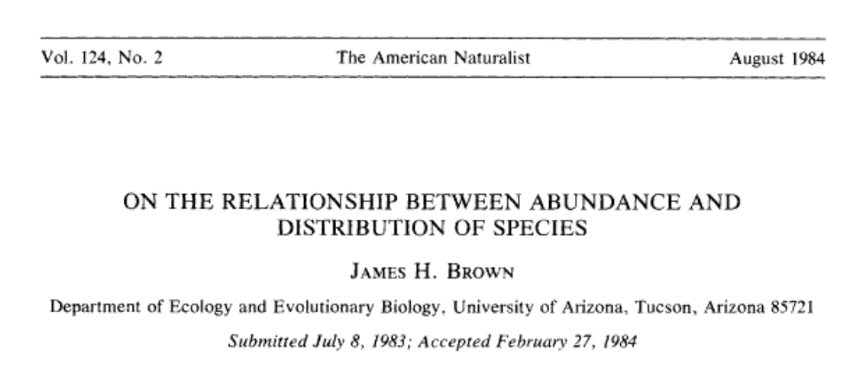
Niche structure and limits
Abundance-Center Hypothesis:
Species are more abundance towards the geographic center of the range.
Abundance
Distance from range center
Brown (1984) On the Relationship between Abundance and Distribution of Species. The American Naturalist. 124(2) 255-279.

Slide 7
Niche structure and limits
Mean density
Abundance-Center Hypothesis:
Species are more abundance towards the geographic center of the range.
Distance from center of distribution (km)
Mean Density
Brown (1984) On the Relationship between Abundance and Distribution of Species. The American Naturalist. 124(2) 255-279.

Slide 8
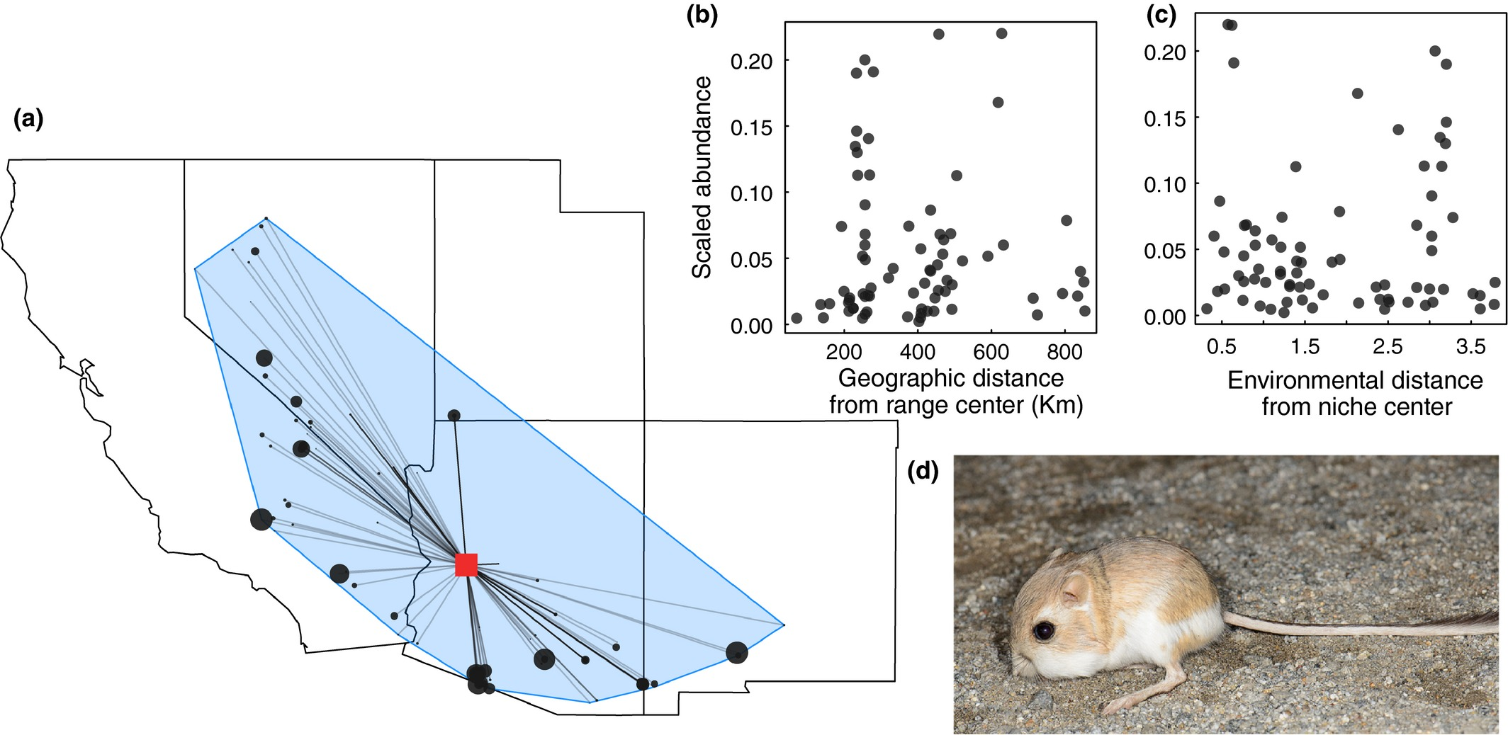
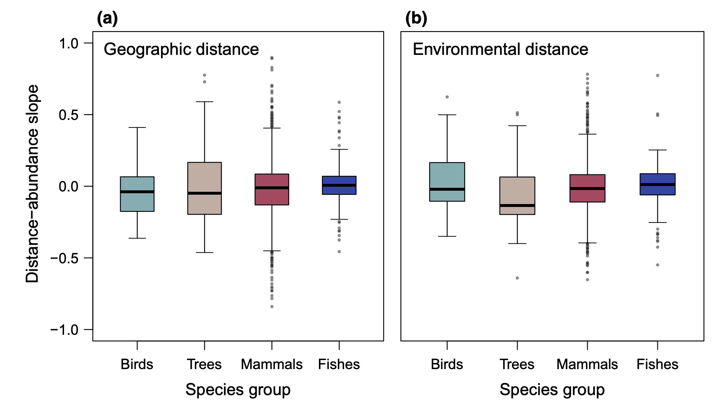
Niche structure and limits
Abundance-Center Hypothesis:
Species are more abundance towards the geographic center of the range.
For >1,400 species of birds, trees, mammals, fishes:
Dallas et al. (2017) Species are not most abundant in the centre of their geographic range or climatic niche. Ecology Letters. 10.1111/ele.12860

Slide 9
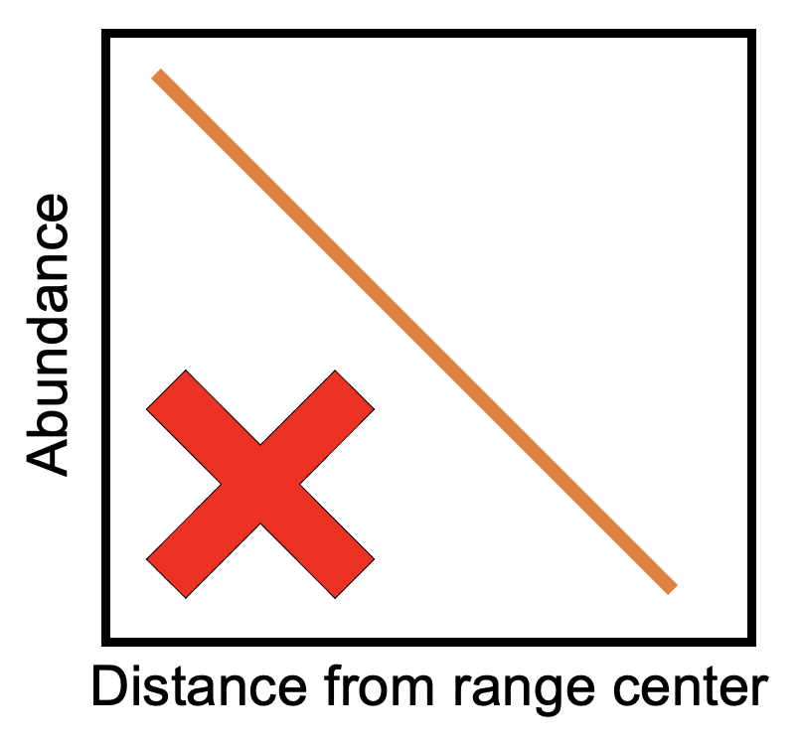
Niche structure and limits
Abundance-Center Hypothesis:
Species are more abundance towards the geographic center of the range.
For >1,400 species of birds, trees, mammals, fishes:
Why not?
Dallas et al. (2017) Species are not most abundant in the centre of their geographic range or climatic niche. Ecology Letters. 10.1111/ele.12860

Slide 10

Pitfalls
Other (Unmeasured? Unknown?) variables may be most important determinants of a species distributions

Slide 11
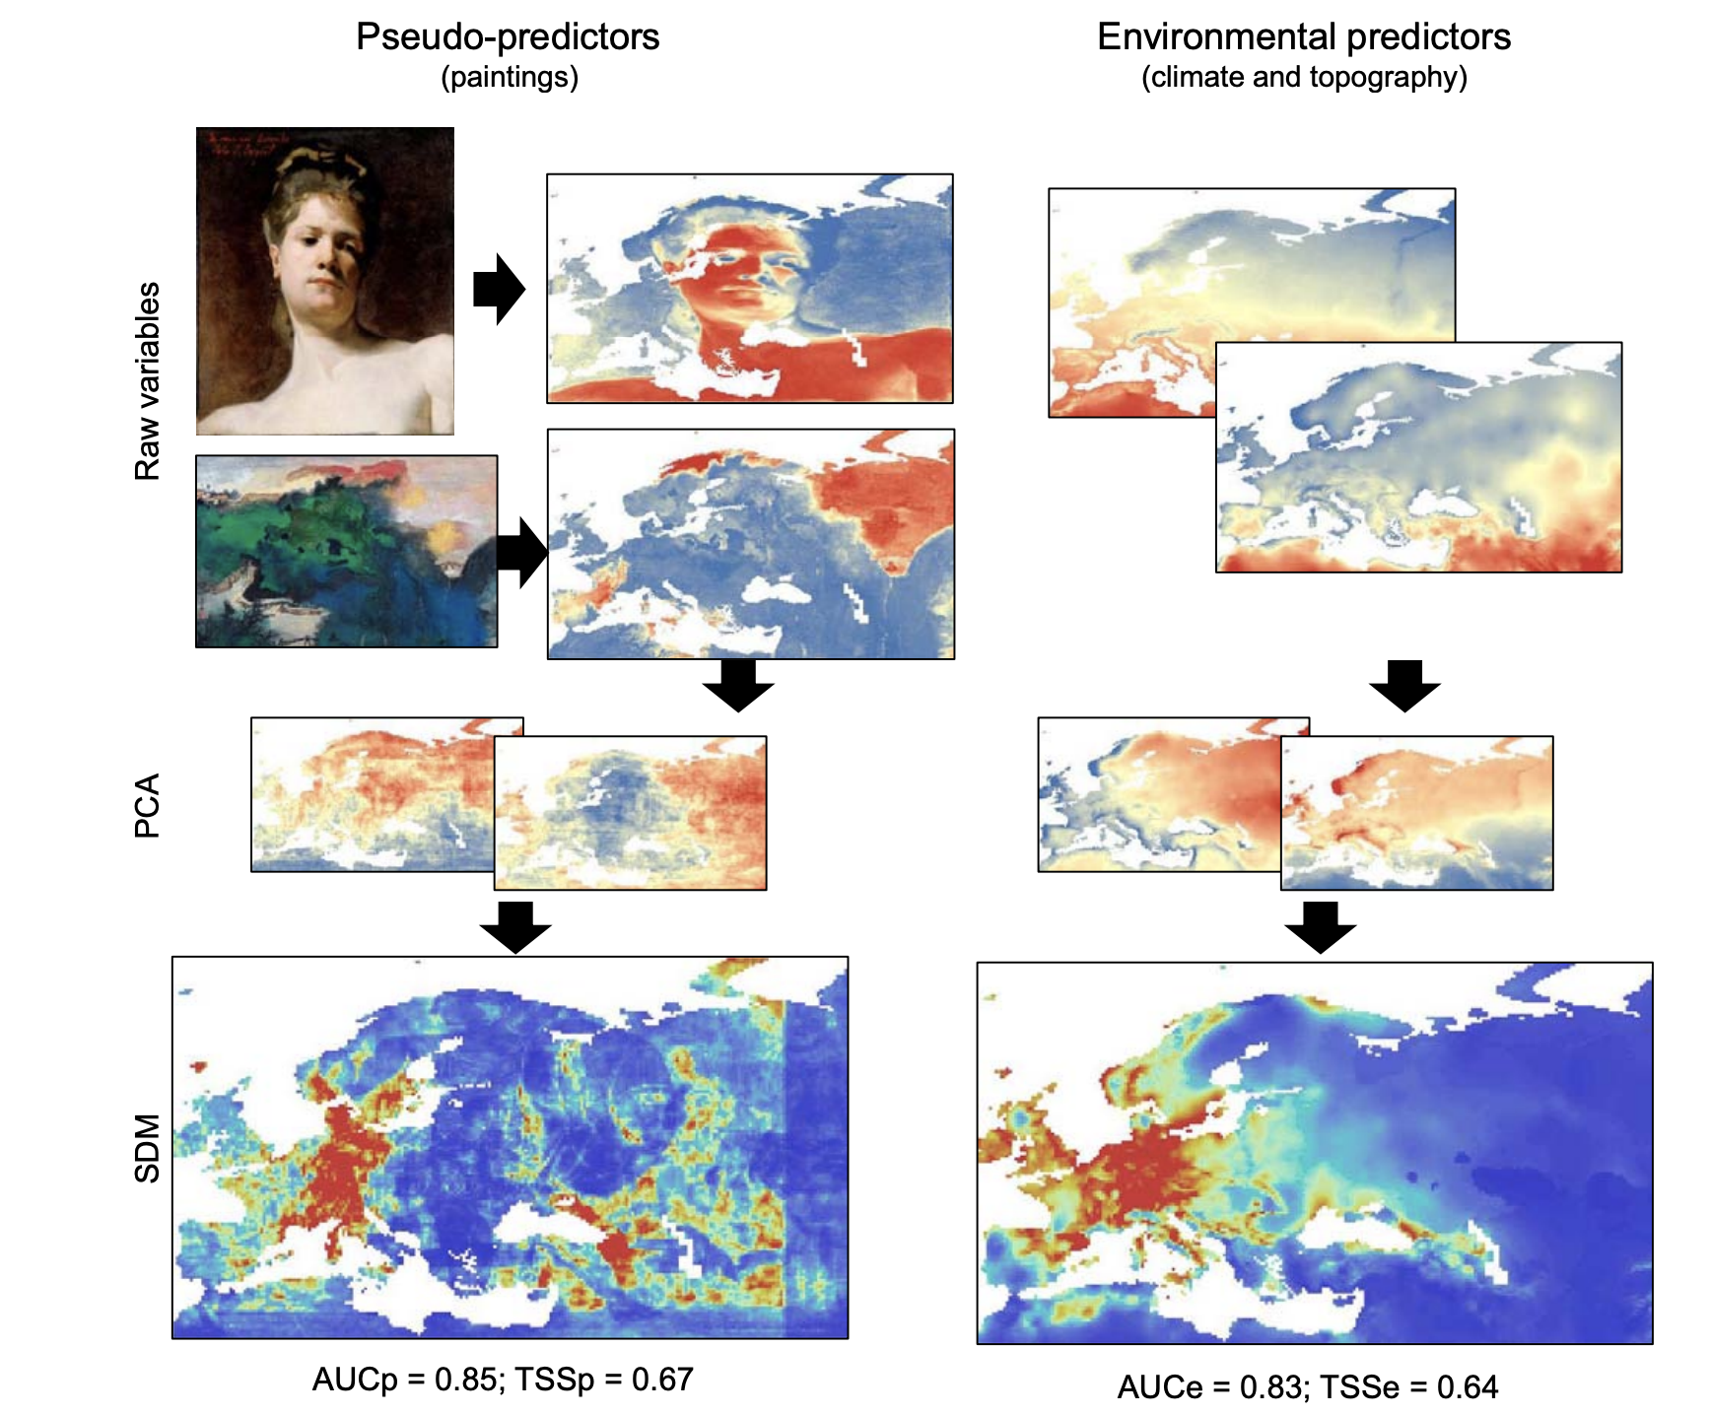
Pitfalls
“Environmental” variables derived from paintings did as good (or better) at predicting species distributions as commonly used bioclimatic variables.
Metrics of “model performance” do not assess the biological significance of SDMs.
Variable selection needs to be hypothesis-driven, connected to the ecology of the study species.
Fourcade et al. (2018) Global Ecology and Biogeography, 27, 245-256.

Slide 12
Pitfalls
Other (unmeasured) variables may be most important determinants of a species distribution
A species may not be in equilibrium with the environment
Abundance (presence) is not highest where fitness is highest

Slide 13
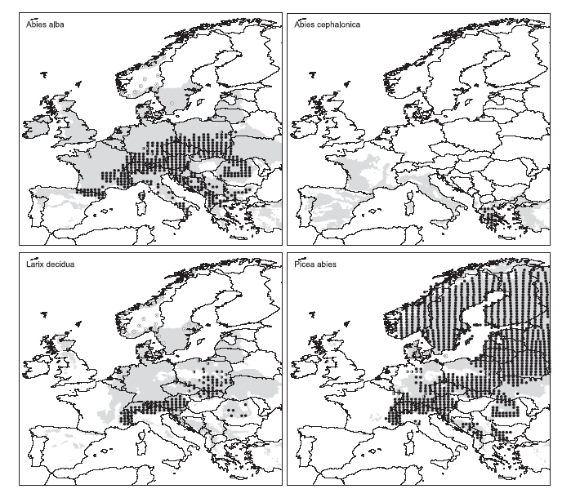
Pitfalls
Native
Naturalized
Potential
Climatic range
Limited filling of the potential range in European tree species
Svenning & Skov (2004) Ecology Letters
Notes:
Observed distribution according to Atlas
native (black circles), naturalized (i.e. established alien; empty circles), extinct or probably extinct (cross), and present, but of doubtful or unknown status, e.g. whether native or alien (half-filled circles).

Slide 14
Potential?
Predicting suitable areas under climate change
Spread of an invasive species
Population growth rate
Celastrus orbiculatus in Maine
Suitable tree habitat in Greenland
Merow et al. 2011 Am. Nat.
Normand et al. 2013 Phil. Trans. Royal. Soc.
Notes:
I’ll just show a couple of quick examples. On the left is a study of an invasive plant in Maine. In that case, the predictions of invasion patterns were improved by incorporating models for dispersal and demographic spread. On the right is a recent study done by one of the people in the group where I am now based looking at areas of Greenland that will become suitable for tree colonization under climate change. By integrating information on dispersal rates, they quantified the lag time between when the climate becomes suitable and when trees are expected to colonize.
I think continuing to develop methods for integrating this type of information will lead to some really exciting developments of this type of models.

Slide 15
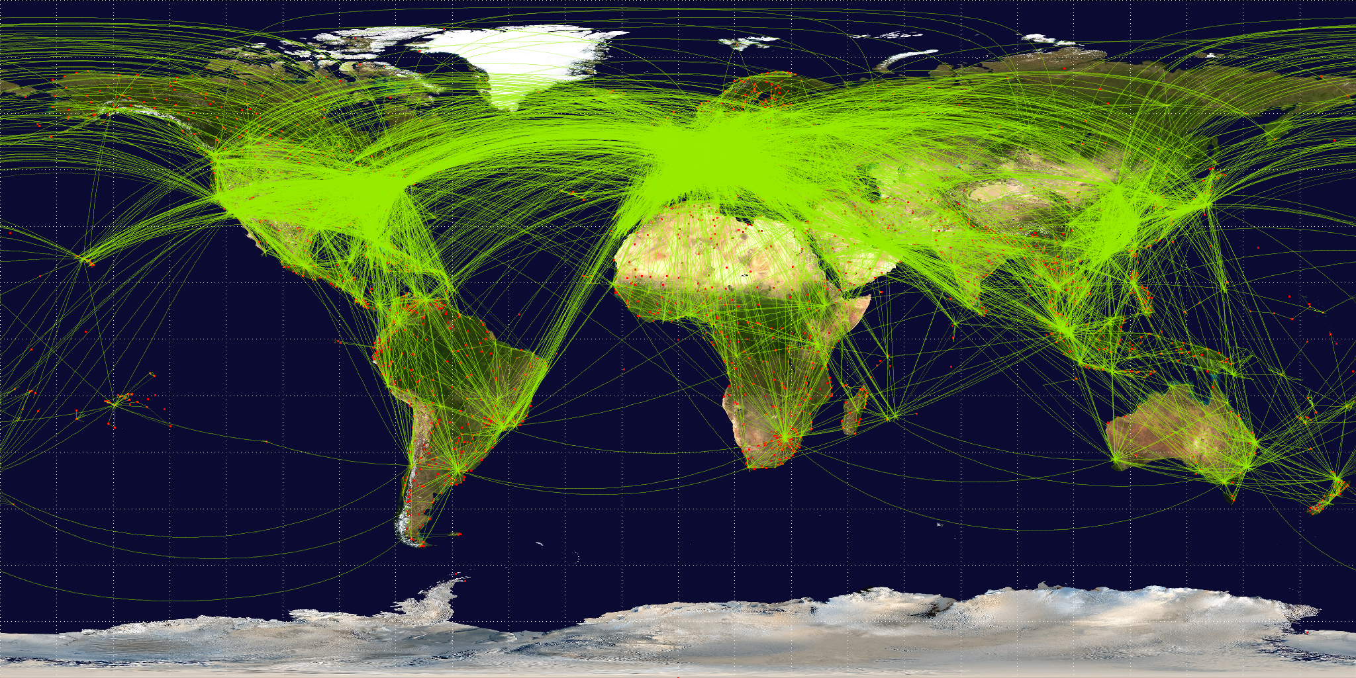

Slide 16
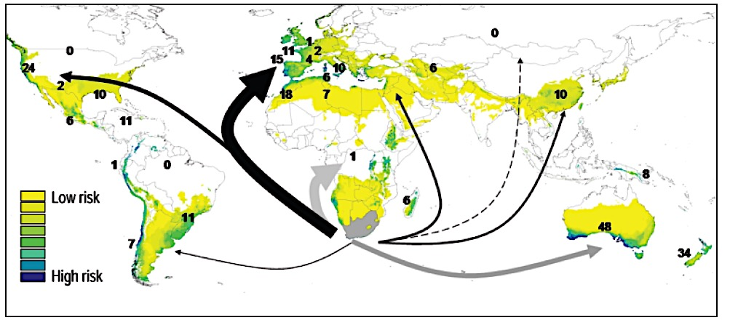
Potential?
Suitable habitat for South African ornamental plants predicts invasion success
e.g., Carpobrotus edulis
Thuiller et al. 2005 Glob. Change Biol.
Notes:
A set of tools that has been very important for this question are models of habitat suitability, which generally make predictions about the spatial distribution of suitable habitat for a species based on the abiotic conditions in locations where it is known to occur. This example that looked at the global invasion potential for a group of South African ornamental plants. By identifying the areas with similar climatic conditions as South Africa, the authors were able to predict the risk of invasion from these species.
A major limitation with most of this type of model is that while they may do a good job at predicting areas where a species could potentially establish, they often don’t incorporate mechanisms that will tell us more about where a species WILL establish.

Slide 17
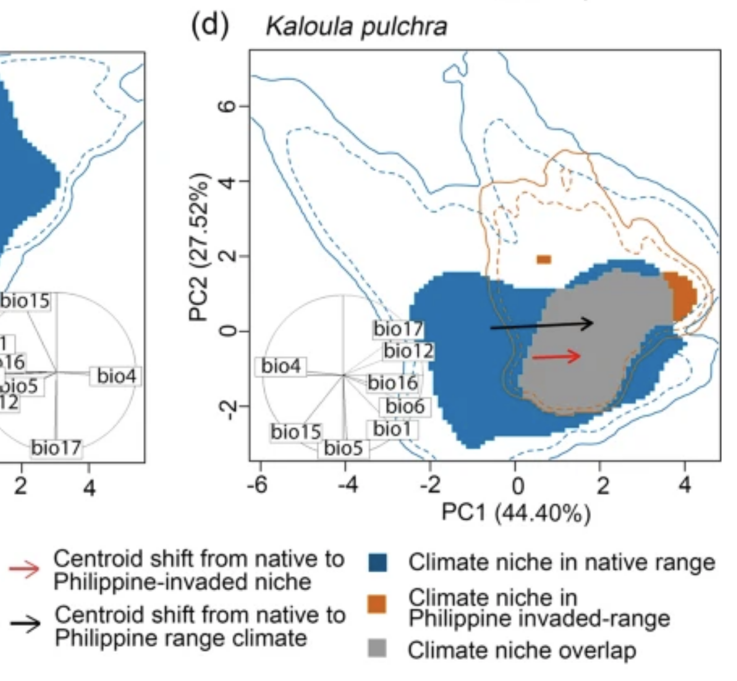
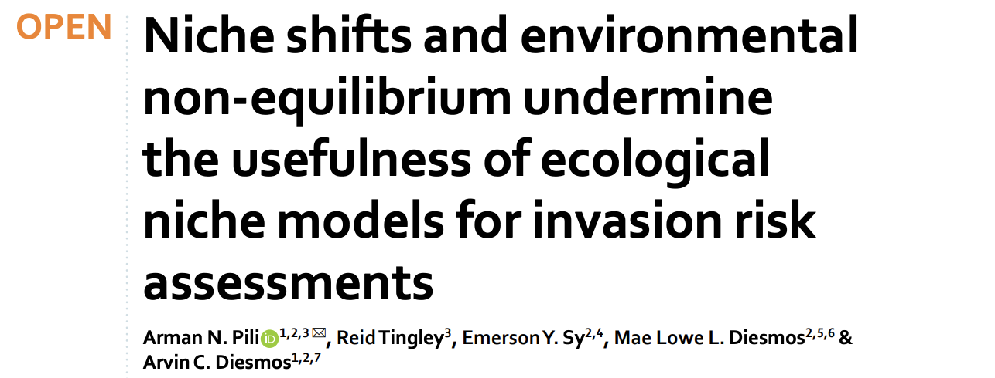
Invasive species
Pili et al. (2020) Scientific Reports

Slide 18
Invasive species
Niche shifts and environmental non-equilibrium challenge our ability to predict potential distributions
Pili et al. (2020) Scientific Reports

Slide 19
Pitfalls
Other (unmeasured) variables may be most important determinants of a species distribution
A species may not be in equilibrium with the environment
Abundance (presence) is not highest where fitness is highest
Are we using best practices?

Slide 20
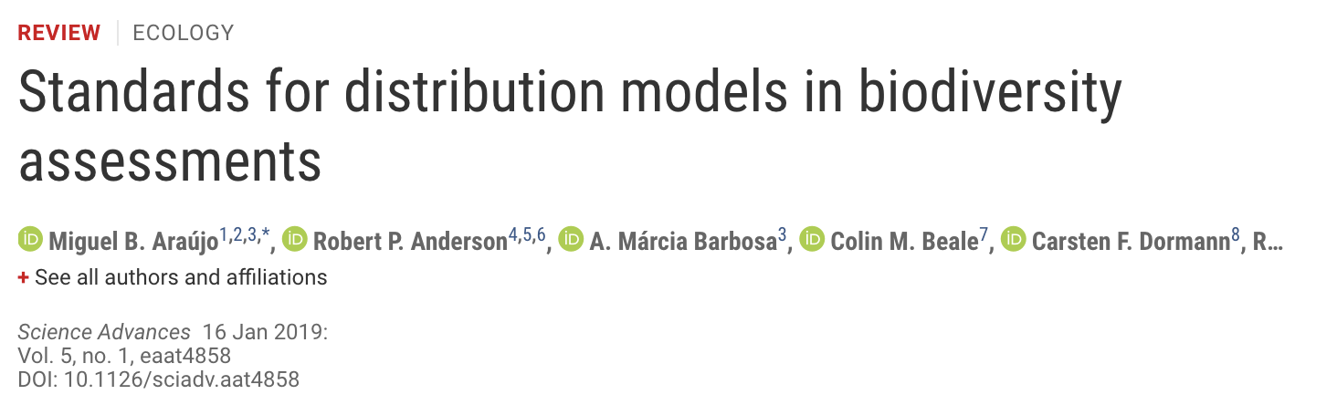
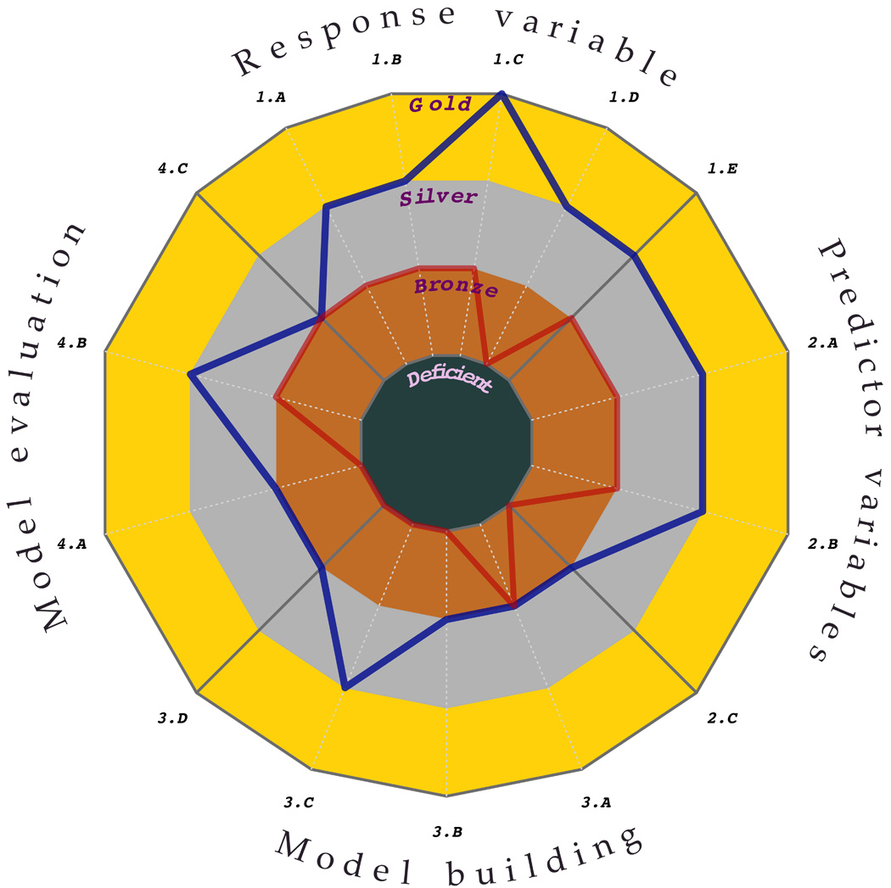
Top 90%
Top 50%
Araújo et al. (2019) Standards for distribution models in biodiversity assessments. Science Advances
Notes:
Uses of SDMs. Classification of published species distribution modeling studies by (A) type of biodiversity assessment accomplished with the trend in the numbers of studies shown over time and (B) purpose of the model (see glossary in text S4). In (A), the trend for translocation is very similar to that of restoration, and hence is hardly visible. The classification is based on a random sample of 400 papers (of 6483 identified articles mentioning statistical models of species distributions); 238 of the randomly selected papers used SDMs and were included in this analysis. Details on the literature search and analyses appear in text S1, figs. S1.1, S1.2, S1.3, and S1.4, and tables S1.1, S1.2, and S1.3.

Slide 21
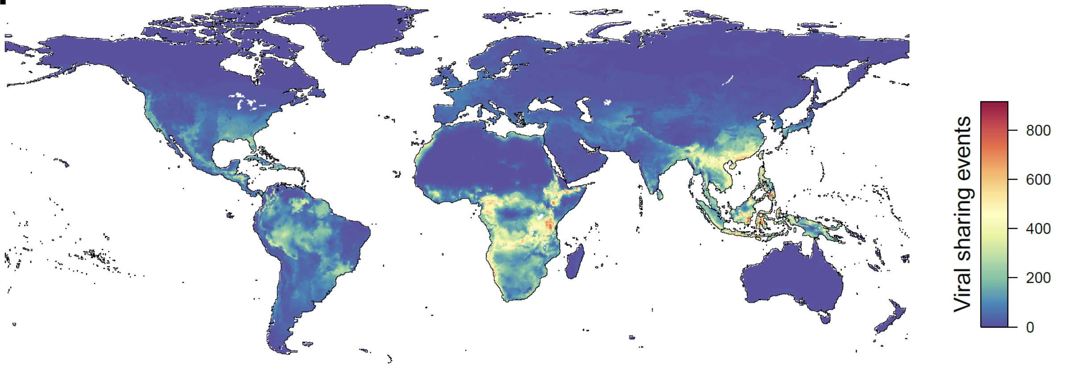
Emerging infectious disease
Carlson et al. (2020) Climate change will drive novel cross-species viral transmission. bioRxiv:2020.2001.2024.918755.

Slide 22

Summary
SDMs/ENMs are relevant for an extremely broad range of applications
Some key assumptions are rarely met (e.g., environmental equilibrium)
Best practices are … not always … used
Yet, these types of models can be extremely useful (understanding, prediction, communication)
MAKE GOOD
SDMs

